Slide 1
12574 – New Year

Slide 2
Description
Bob is a young kid. He thinks New Year is a tradition that involves many troublesome events such as family reunion, etc. Luckily, there is always one event that can cheer him up - receiving red envelopes.
However, only his parents, uncles (disregard uncle-in-law), aunts (disregard aunt-in-law), grandparents, grand-grandparents, grand-...-grandparents will give him one red envelope in New Year's Eve (circled in the family tree).
"New Year Family Tree". (Relatives in blue nodes are those who will give Bob red envelopes)
Given Bob's "New Year Family Tree", please tell Bob how many envelopes he can get.

Slide 3
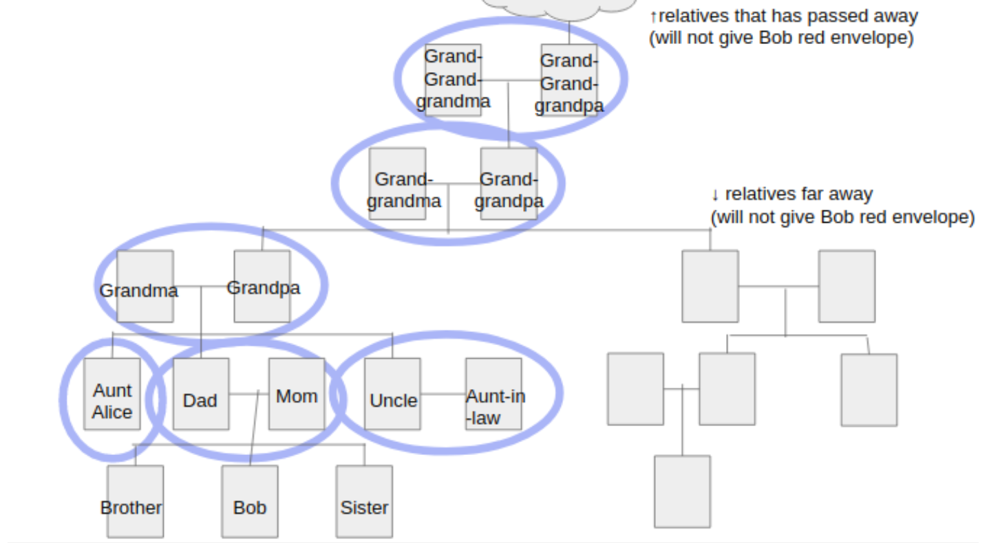
Who will give Bob one red envelope in New Year's Eve

Slide 4
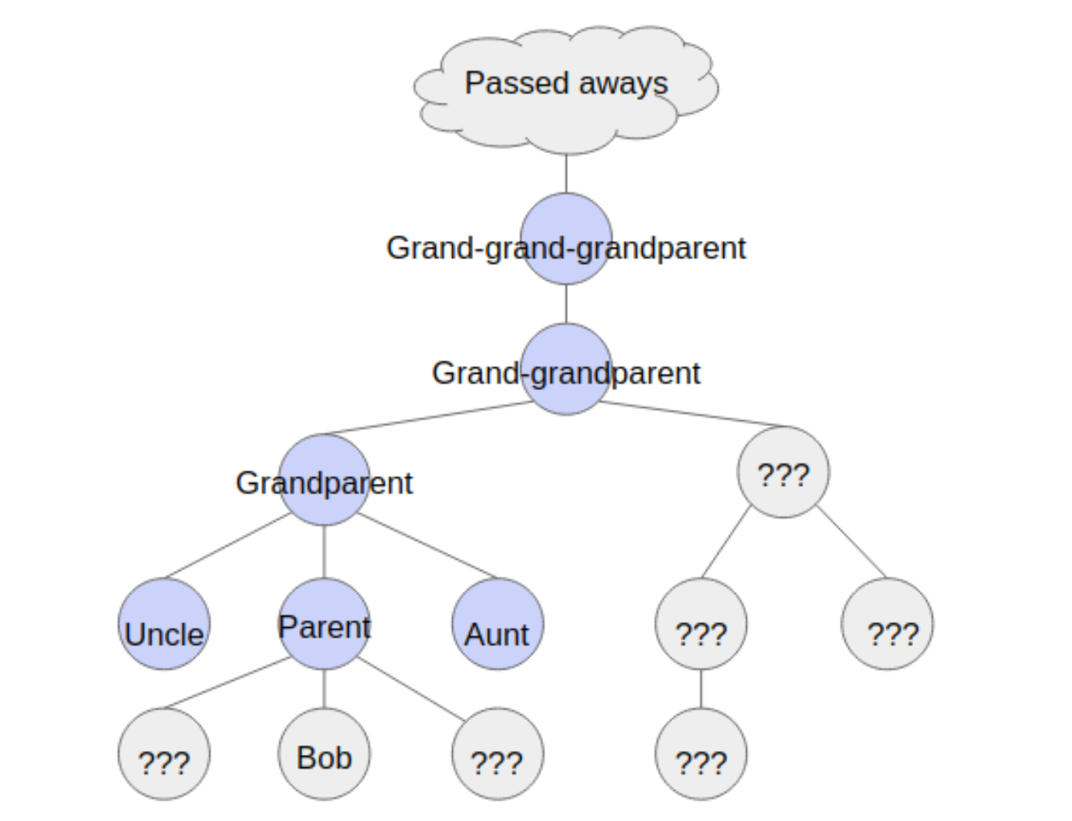
New Year Family Tree

Slide 5
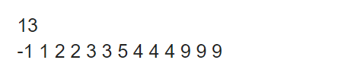
Input
Sample Input
The input is in the following format :
N
P1 P2 P3 … PN
N is an integer which means there are N people in the "New Year Family Tree" (including Bob). People are numbered from 1 to N. Bob is numbered with N.
There are N integers in the second line. Pi (the i-th number counted from the left) is the parent of person i. If Pi = -1, it means that person i 's parent is too old and has passed away.
1 <= N <= 10^5
Only the oldest grand-...-grandparent has passed away in the "New Year Family Tree"

Slide 6

Output
Output how many red envelopes Bob will get. Remember to add a newline character in the end.
Sample Output

Slide 7
Idea
Calculate how many ancestors.
Calculate how many parents, uncles, aunts.

Slide 8
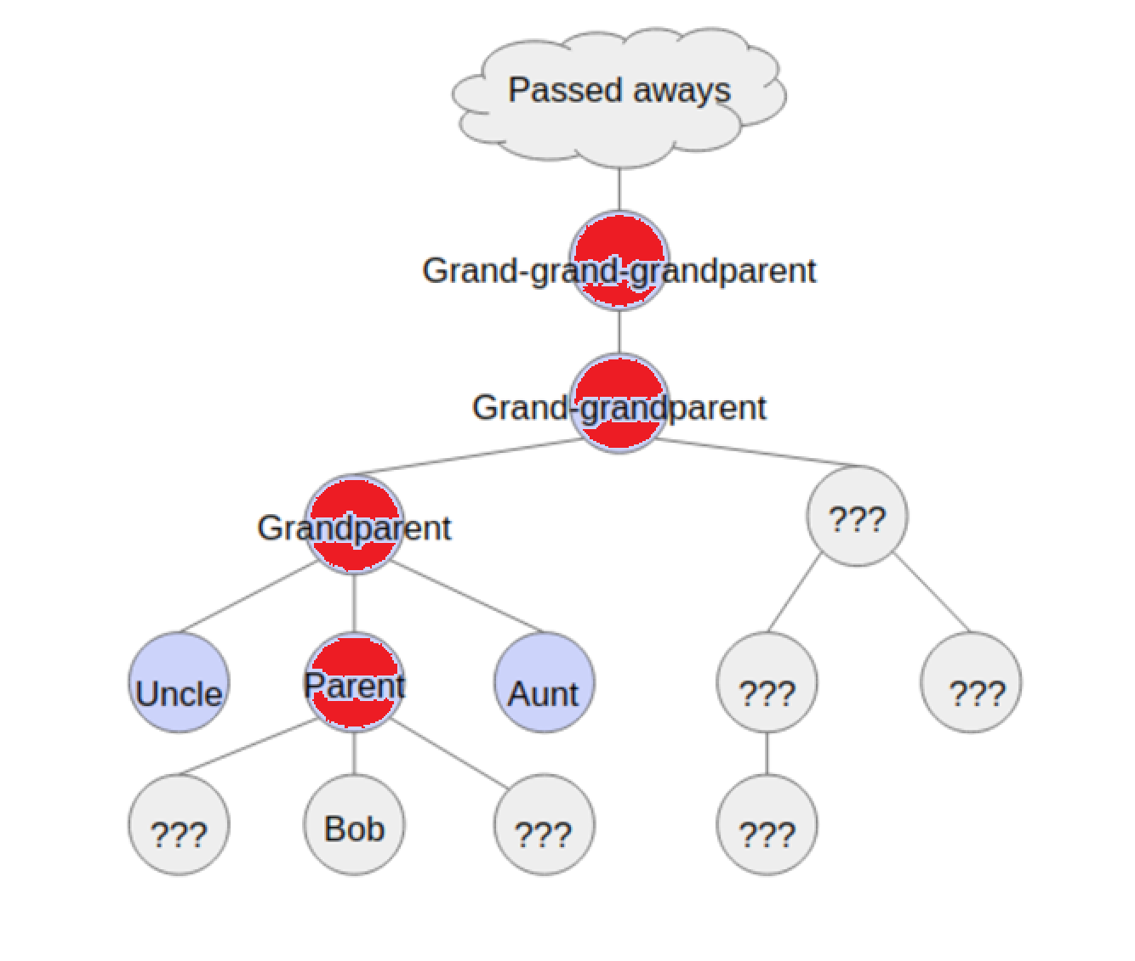
How to calculate the number of ancestors?
Only calculate red parts. (Direct Blood Relative)

Slide 9
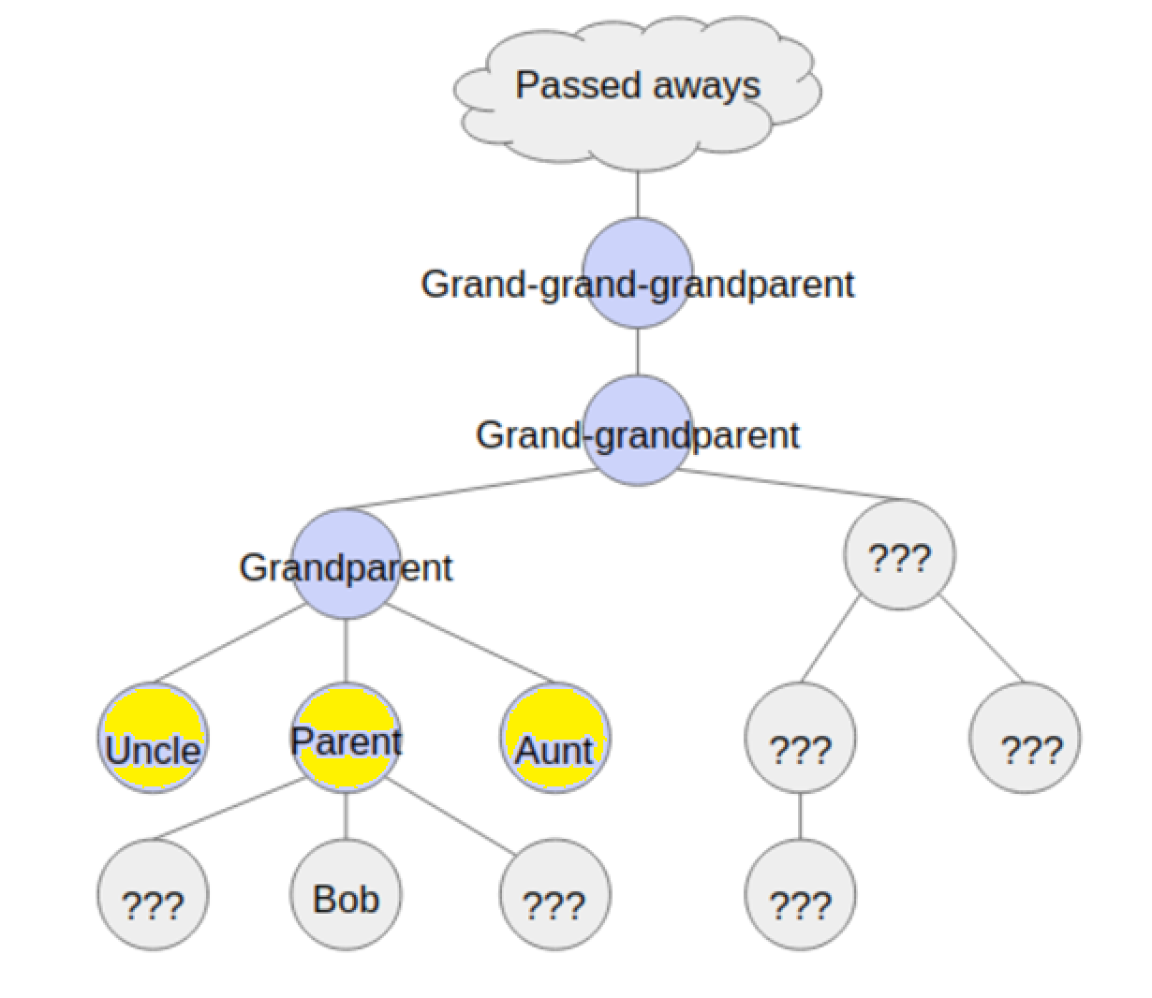
How to calculate the number of parents, uncles, aunts?
Only calculate yellow parts. (Who have the same parents)

Slide 10
The main function
#include <stdio.h>
#define N 100005
int n;
int pa[N];
int main() {
scanf("%d", &n);
for(int i = 1; i <= n; i++)
scanf("%d", &pa[i]);
int ans = 0;
ans += parent_uncle_aunt();
ans += ancestors();
ans -= 1; // "parent" is counted twice
printf("%d\n", ans);
}
Parents’ ID

Slide 11
Code for calculate the number of ancestors?
int ancestors() {
int cnt = 0;
for(int p = pa[n]; p != -1; p = pa[p])
cnt++;
return cnt;
}
Person who passed away
p = pa[n]

Slide 12
Code for calculate the number of ancestors?
int ancestors() {
int cnt = 0;
for(int p = pa[n]; p != -1; p = pa[p])
cnt++;
return cnt;
}
Person who pass away
Next p

Slide 13
Code for calculate the number of ancestors?
int ancestors() {
int cnt = 0;
for(int p = pa[n]; p != -1; p = pa[p])
cnt++;
return cnt;
}
Person who pass away
Next p

Slide 14
Code for calculate the number of ancestors?
int ancestors() {
int cnt = 0;
for(int p = pa[n]; p != -1; p = pa[p])
cnt++;
return cnt;
}
Person who pass away
Next p

Slide 15
Code for calculate the number of ancestors?
int ancestors() {
int cnt = 0;
for(int p = pa[n]; p != -1; p = pa[p])
cnt++;
return cnt;
}
Person who pass away
P = -1

Slide 16
Code for calculate the number of ancestors?
int parent_uncle_aunt() {
int grandparent = pa[pa[n]], cnt = 0;
for(int i = 1; i <= n; i++)
if(pa[i] == grandparent)
cnt++;
return cnt;
}
pa[i₁]
grandparent

Slide 17
Code for calculate the number of ancestors?
int parent_uncle_aunt() {
int grandparent = pa[pa[n]], cnt = 0;
for(int i = 1; i <= n; i++)
if(pa[i] == grandparent)
cnt++;
return cnt;
}
pa[i₂]
grandparent

Slide 18
Code for calculate the number of ancestors?
int parent_uncle_aunt() {
int grandparent = pa[pa[n]], cnt = 0;
for(int i = 1; i <= n; i++)
if(pa[i] == grandparent)
cnt++;
return cnt;
}
grandparent
Pa[i₃]

